Slide 1



Privacy Policy Snapshot Challenge
Mission statement:
Empower consumers in the management of their privacy.
By

Slide 2
The problem
There is a broad range of new consumer health technologies that collect and manage people’s information.
Most people are unaware of how their information is being used, because:
Privacy policies are lengthy and not being read, and
Privacy policies are too technical and difficult to understand.
There is not an easy way of comparing privacy policies among different apps.
Developers are not familiar with privacy policies and their technicalities.

Slide 3

The solution
A wizard that will help developers generate the privacy policies they need for their apps, with a strong focus in the consumer, to make sure they understand how their information is being managed.

Slide 4





The team
Technology lovers who have been working in Health IT for over a decade
Federico
Tarantini
Carlos
Cucurullo
Yanina
Libenson
Marina Komarovsky
Lionel
Cuevas
Software Specialist
UX & Design Specialist
Project Manager
Research Specialist
Software Specialist

Slide 5
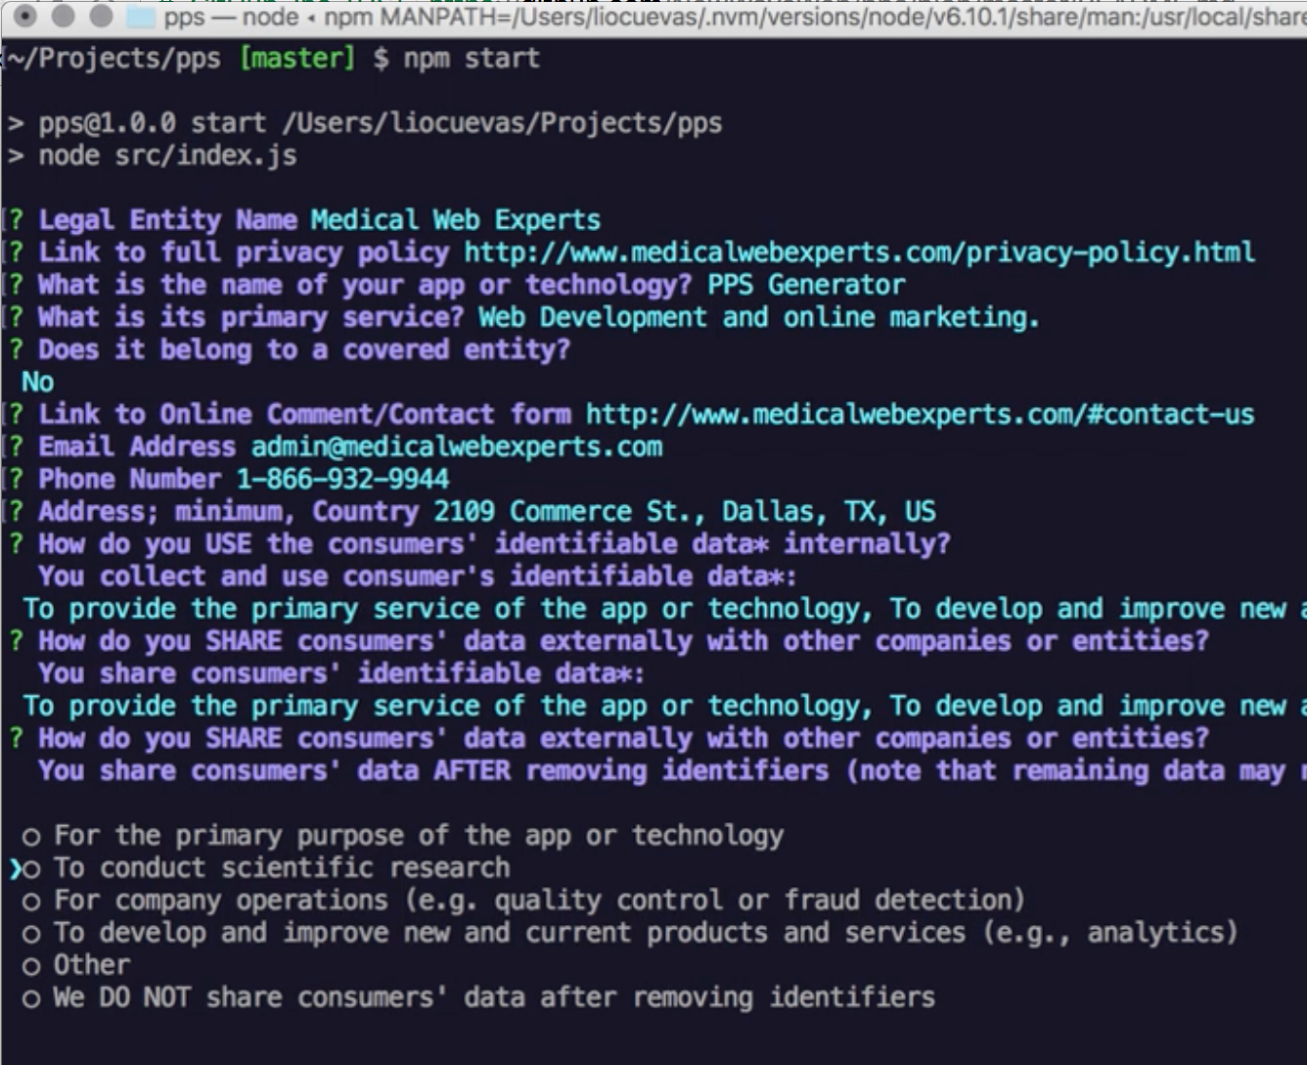
For Developers
A command-line application with a wizard to generate the Privacy Policy Snapshot.
[Requirements]
Install node and npm
node version +v6.10.1
npm version +v3.10.10
yarn (optional)
[Installation]
git clone git@github.com:NewWaveWeb/pps.git
[Usage]
cd pps/ # Enter pps folder npm install # Install Dependencies with npm install or yarn npm start # Run the app or node src/index.js

Slide 6

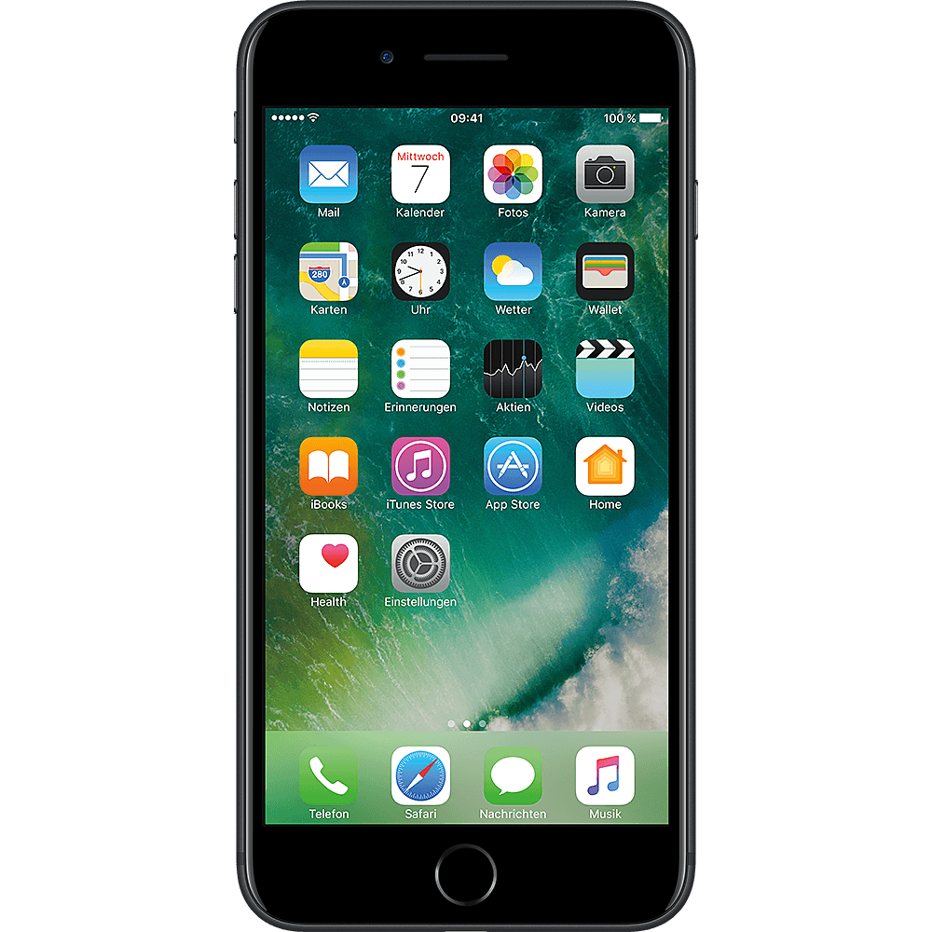
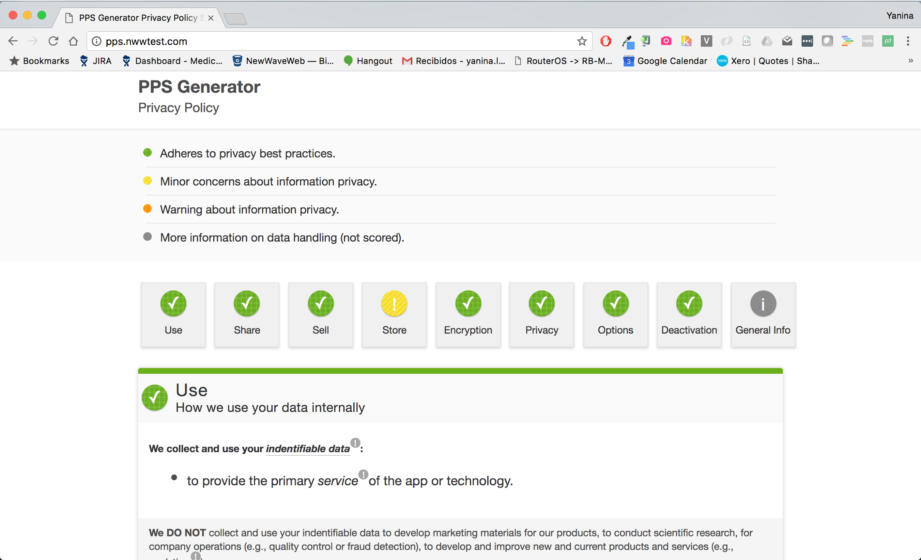
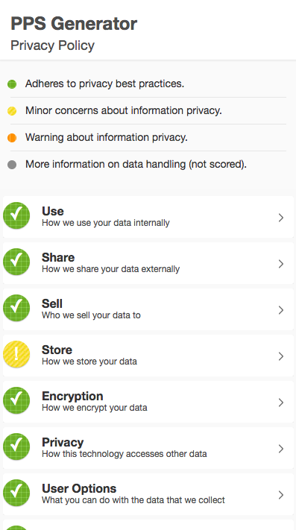
For Consumers
An easy-to-understand, easy-to-navigate mobile-responsive Privacy Policy.
Color-coded scoring system to bring attention to warnings consumers need to be aware of
ADA Compliant:
Textures for people suffering from color-blindness
Text-to-speech ready
Easy to navigate
Easy to understand
Mobile-responsive
Easy-to-access concept definitions

Slide 7

Consumer Testing
User Surveys
8 surveys completed
10 multiple choice, open ended, and Likert scale items
Respondents were men and women ages 24-65
Focus Group
10-Member focus group
Participants were executives, developers, and marketers

Slide 8


Perspectives on Data Privacy (Survey)
75% of users never review the privacy policy before using an application
50% of users expressed that the privacy policy is usually long, boring, time-consuming, or difficult.
Top concerns about privacy of health information when using an app were that it may be sold (62.5%) and that privacy may be compromised during transmission (50%).
Provided with ten categories of health information that may be used in a health application, users felt most strongly about the privacy of test results (75%), followed by the privacy of diagnoses, medications, and insurance information (62.5% each).

Slide 9
Experience Using Privacy Policy (Survey)
Highlights
87.5% of users found the visual presentation of the information clear
75% of users indicated that:
The Privacy Policy was well organized
Explanations and definitions were easy to understand
They were able to find the privacy practice information important to them
Areas to Improve
Only 50% of users immediately understood the purpose of the document
Only 50% of users felt it was clear where to click for more information

Slide 10
Lessons & Directions (Survey, Focus Group)
Advantages of This Tool
Practical for developers without legal staff to create privacy policy.
Something that is custom-made and reliable, and saves money and time.
For users, visually engaging, easy to read, and informative.
Version 2.0
To make the scoring system more clear, add the color key at the top instead of the bottom.
To improve desktop navigation, add an arrow to go back to the top.
Soften the scores, to make the privacy policy more attractive for developers. Remove the overall score and change the red warning to an orange one.
Adjust font styles and sizes to make content grouping intuitive.
Version 3.0
Incorporate a template for generating the full privacy policy (accessible at the bottom).
Better balance benefits to users (understanding privacy concerns) and benefits to developers (easy privacy policy generator that does not devalue the app’s practices).
Optimal Definitions for Users
We tested four definitions for each key term to determine which were most user-friendly.

